Slide 1
Max MSP External Objects
By Jan Reinberg

Slide 2
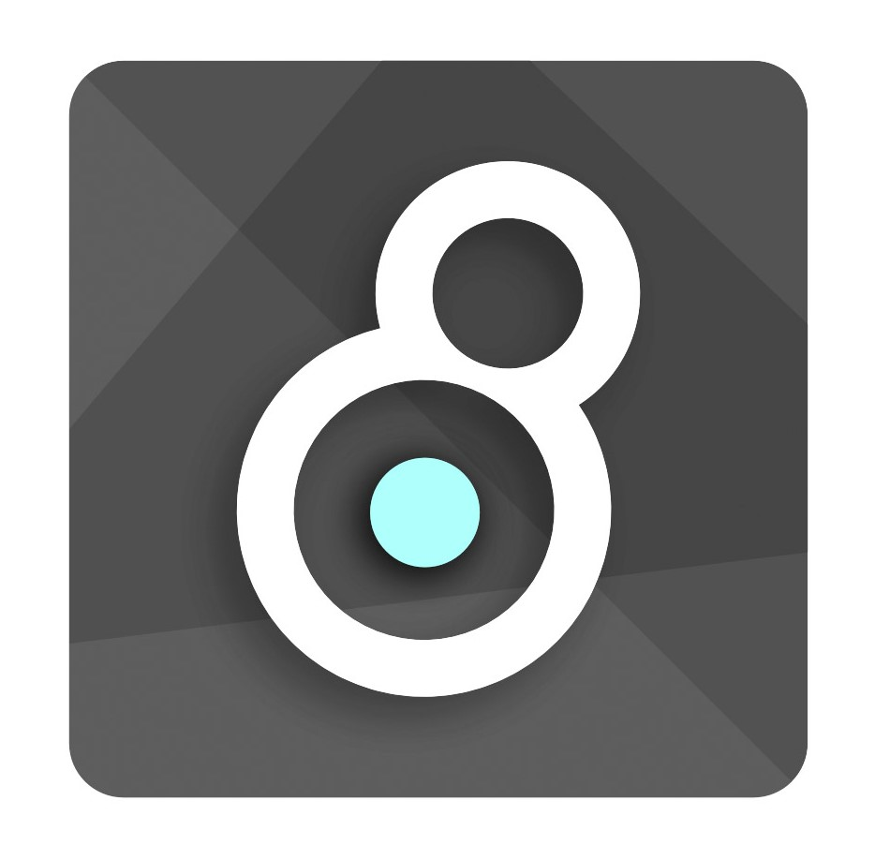
Introduction to Max
Max is a versatile visual programming language; rather than using a traditional scripting language, programmers use visual nodes or “objects” that are connected via “patch cords” that represent a signal flow.
It is predominately used for interactive programming in digital multimedia processing.
Very flexible and compatible with various interfaces, multimedia software and hardware.

Slide 3

Brief Max and Cycling ‘74 History
Was primarily developed by David Zicarelli, who derived it from the precursor Patcher language made by Miller Puckette. Patcher was mainly capable of midi and patching controls.
Zicarelli, who was with Opcode, re-designed the language to become Max/Opcode. This included improvements to the graphical interface nature of the language. It was here that external object software development kits were conceived.
Zicarelli, founded the company Cycling ’74, which continues to develop and distribute the language.
Puckette went on to develop Pure Data.

Slide 4
Max functionality
Max patches are comprised of nodes called ”objects” which enable certain functions to the user. Programmers can use objects (called in the IDE using cmd/ctrl + n) to generate sound, video, mathematics, text messages signal processing, etc.
Users can create their own custom objects with the provided software development kit on the Cycling ‘74 site.
Max, unlike Pure Data, is not an open source language. The best way to make external objects is using the SDK, starting with a base template, depending on your intended purpose, and then altering or adding code and building/compiling the code for use in the Max IDE.

Slide 5
Max Objects
There are various objects that can be created for custom use in Max.
This includes regular Max objects, and then MSP and Jitter objects.
MSP (Max Signal Processing) was created in 1997 by Zicarelli, these objects primarily deal with audio signal processing.
Jitter are matrix based that predominately deal with video or visual data.
Other types of objects include GEN, BEAP, and VIZZIE that offer various audio/video, sound synthesis, and visual processing capabilities.

Slide 6
Creating Max MSP external objects:
The best way to create external objects is via the Max SDK
Start with a provided MSP template and adjust the code to fit your purpose.
Max predominately supports external objects written in C. C++ is not officially supported but is possible.
Alternative ways to build objects include Cycling ‘74’s RNBO which is a “no-code” way to build external objects.
There also 3rd party methods. to create external objects for both Max and Pure Data in C++ called Flext, this method was created by Thomas Grill. Another is maxcpp.git available on github.

Slide 7
Resources and set up
You will need to use Xcode for building objects with MacOS and VS Code for building objects within Windows platforms.
Install the respective SDK for your platform.
Best resource to learn about creating MSP and other types of objects is via the provided API Documentation on Cycling ‘74’s resource site.
The best way to go about creating an Max MSP object is to start with the "simplemsp~" as a template.
MSP objects are similar in respect to the templates to a normal Max object, with added features for audio signal processing.

